Slide 1

PS1
HBCSE Presentation
Converting 2D Images to 3D Model
Abhishek Kumar
Aryesh Harshal Koya

Slide 2
INTRODUCTION
What is Photogrammetry?
How does it work?
Comparison b/w openMVG-openMVS and Meshroom
Code for extracting non-blurry frames from a video
Turntable Design
Controlling the turntable
Insect Database
Web app
Documentation

Slide 3
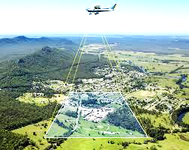
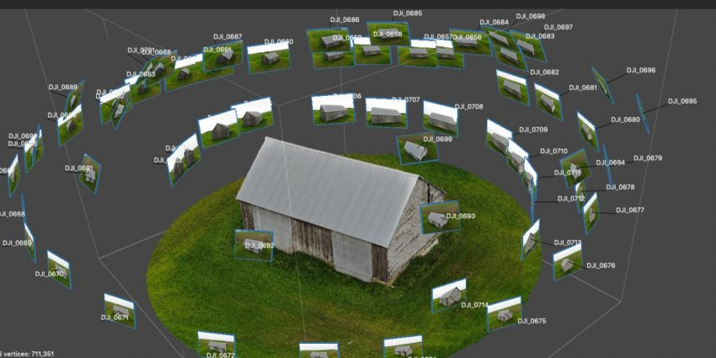
Drawing
Light
Photo-gram-metry
Measurement
Aerial
Stereo(Close Range)

Slide 4
How Does It Work?

Slide 5
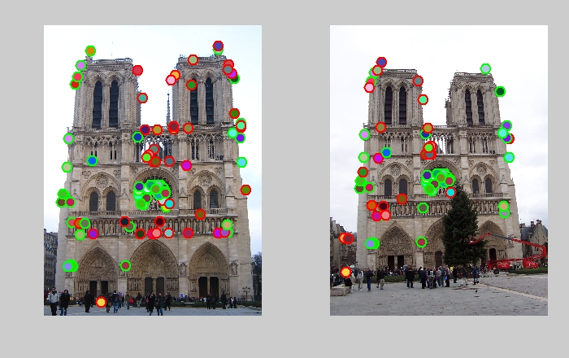
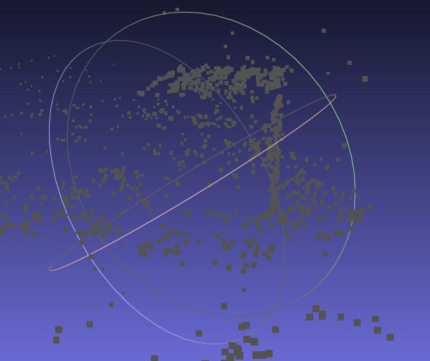
Step 1 - Feature Detection and Matching (SfM)
Image Matching
Structure from Motion

Slide 6
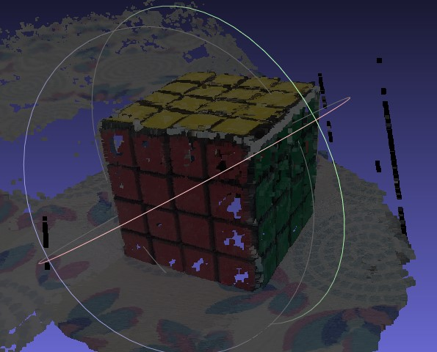
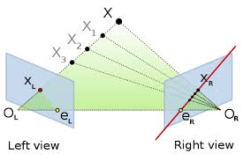
Step 2 - Point Cloud Densification
Outcome
Increases number of points
Gives clarity and detail
How?
Notes:
80%

Slide 7
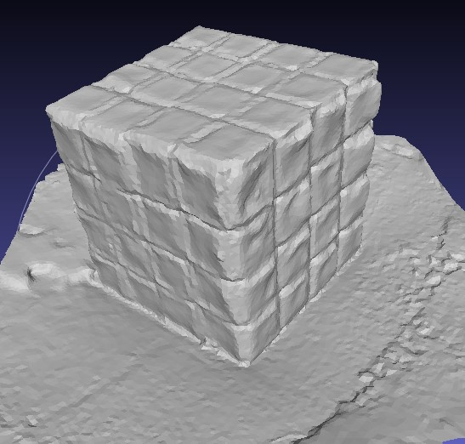
Step 3 - Mesh Reconstruction and Refinement
Reconstruction
Any three points define a plane
Group of planes defines a surface
Refinement
Decimation of the mesh
Lower computation time for texturing

Slide 8
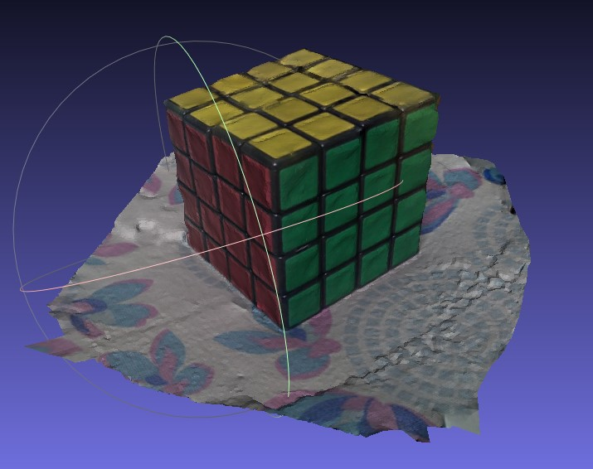
Step 4 - Texture Application
White Mesh
.png file
Coloured Mesh

Slide 9
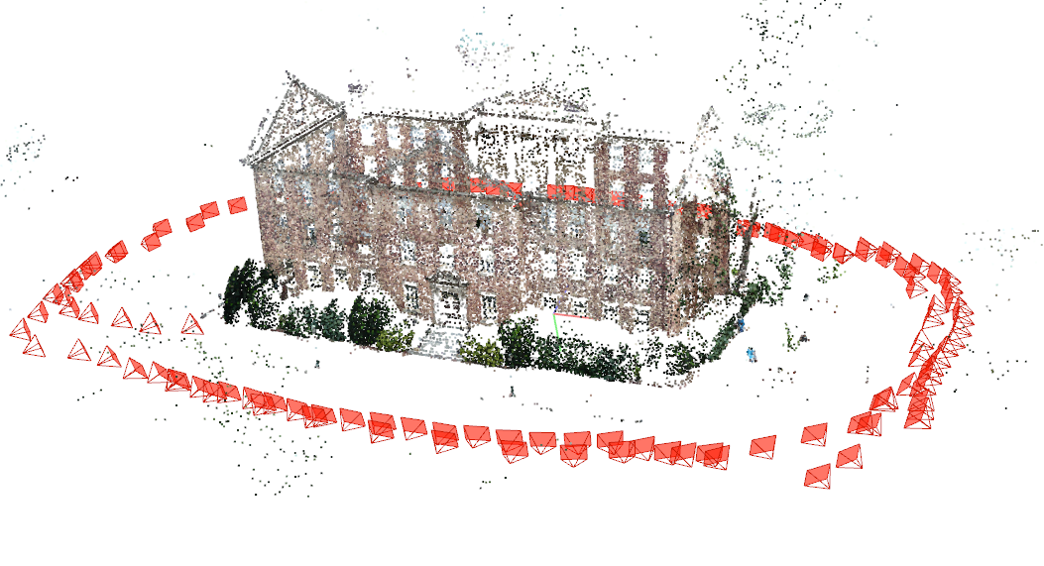
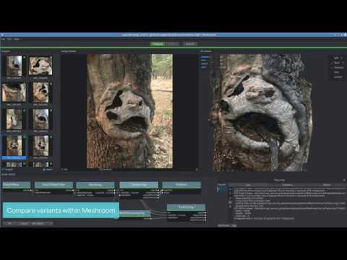
Software/Libraries
openMVG and openMVS
Meshroom
COLMAP
VisualSFM

Slide 10
openMVG - openMVS

Slide 11
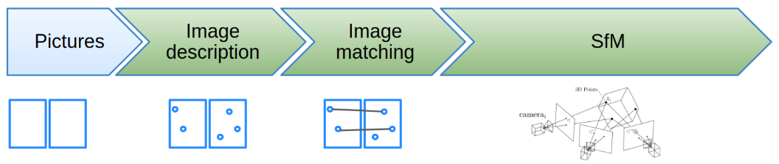
openMVG - open Multiple View Geometry
Provides an end-to-end 3D reconstruction from images

Slide 12
openMVS - open Multiple View Stereo
openMVG (SfM)
Densify point cloud
Mesh reconstruction
Mesh refinement
Texturing

Slide 13
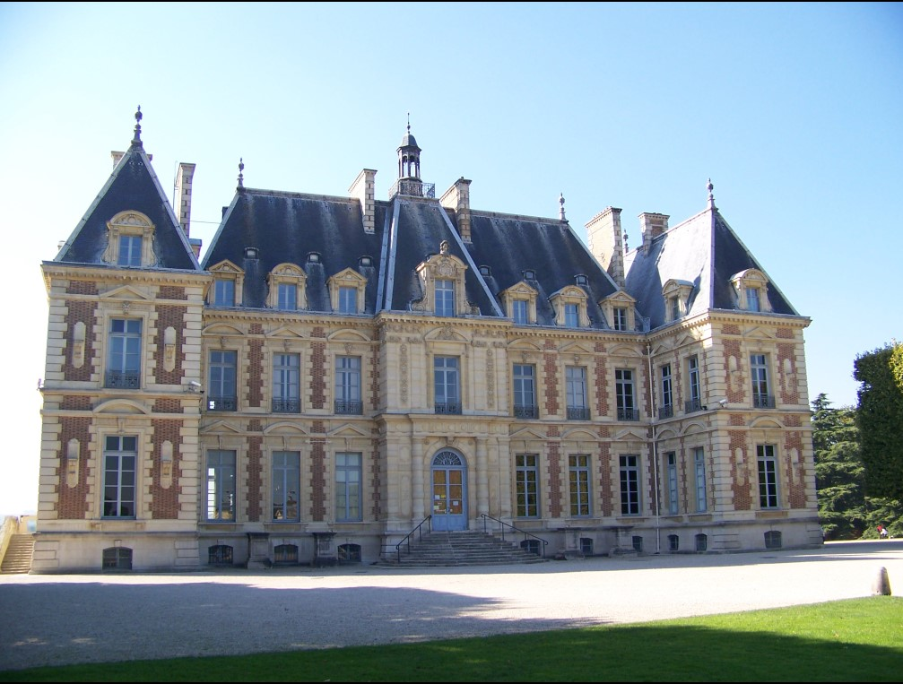
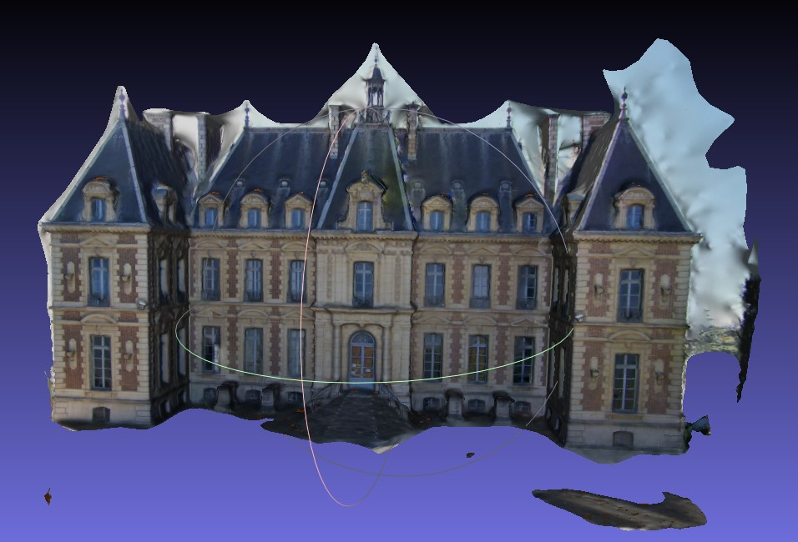
Sceaux Castle Dataset
Learnings: Familiarity with using openMVG-openMVS

Slide 14
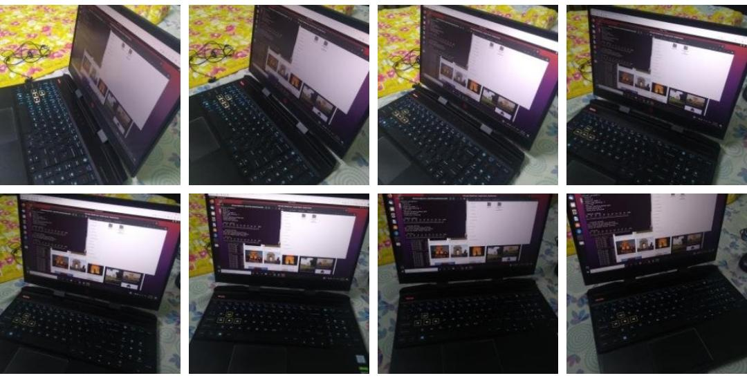
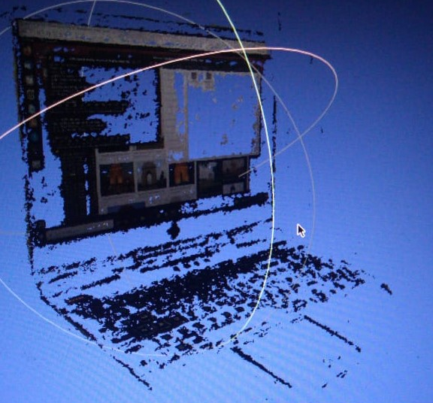
Laptop Dataset
Learnings: More number of input images required with object in focus
Input Images clicked with phone
Output

Slide 15
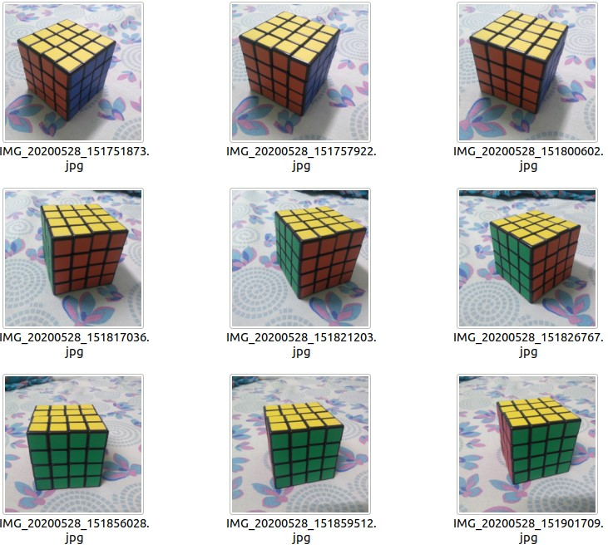
Rubik’s Cube Dataset
Learnings: Good lighting conditions and maximum overlap

Slide 16
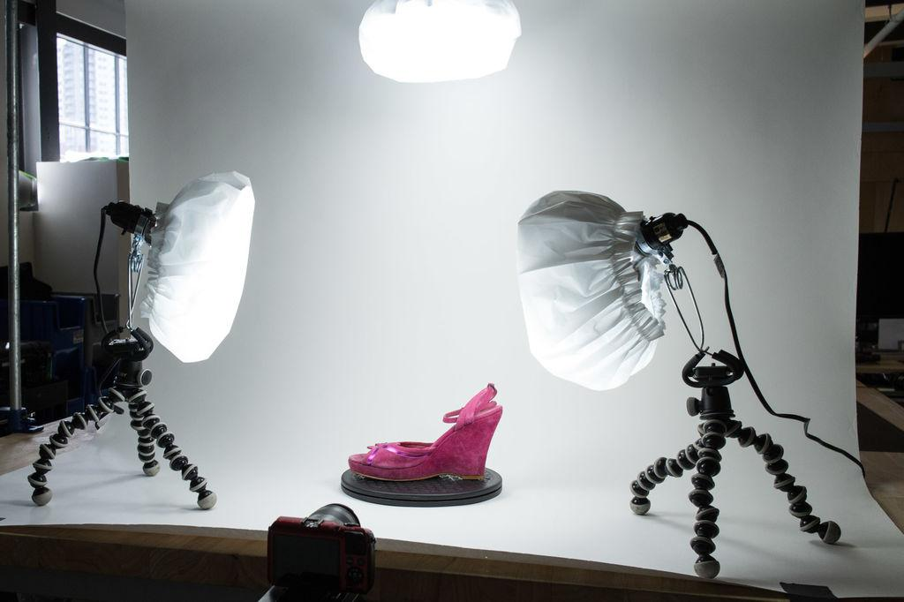
Pre-conditions for Images
Acquiring a large data set
Object well in focus
Maximum overlap b/w consecutive images
Maintaining constant height and distance from object
Good Lighting Conditions
Notes:
Now we had to start thinking of ways to overcome these challenges and if possible automate the process of acquiring the data set so as to minimize the room for errors.

Slide 17
OpenMVG-OpenMVS Vs Meshroom
Notes:
Challenges :
High execution, Additional dependencies -> longer buld times. Takes about an hour to setup both MVG and MVS
Reasons :
Lack of resources, Doesn’t utilize dedicated cards
Meshroom :
Includes binaries, comes with dependencies that don’t need to be compiled individually
Utilizes CUDA, which provides parallel processing through Nvidia GPUs

Slide 18
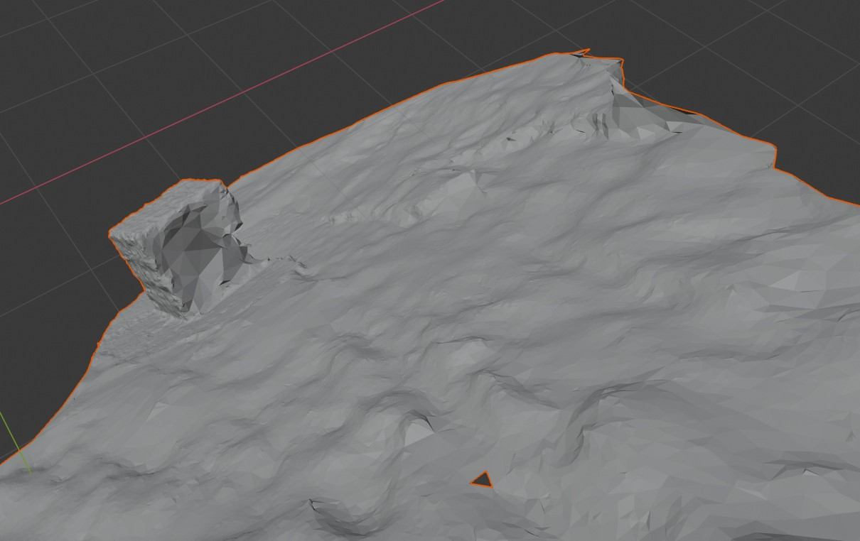
Meshroom Output

Slide 19
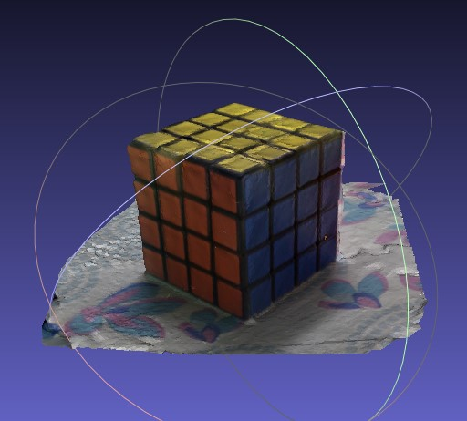
Conclusions
Meshroom output was quicker(3-6x), but broken and not as good as openMVG-openMVS
Only suitable for High resolution images
To be used an intermediary for identifying deficits
OpenMVG-OpenMVS

Slide 20

Script for extracting images from videos
Not feasible to take hundreds of photos
Extracting images from a 360° video eases data collection task
OpenCV used for extraction

Slide 21
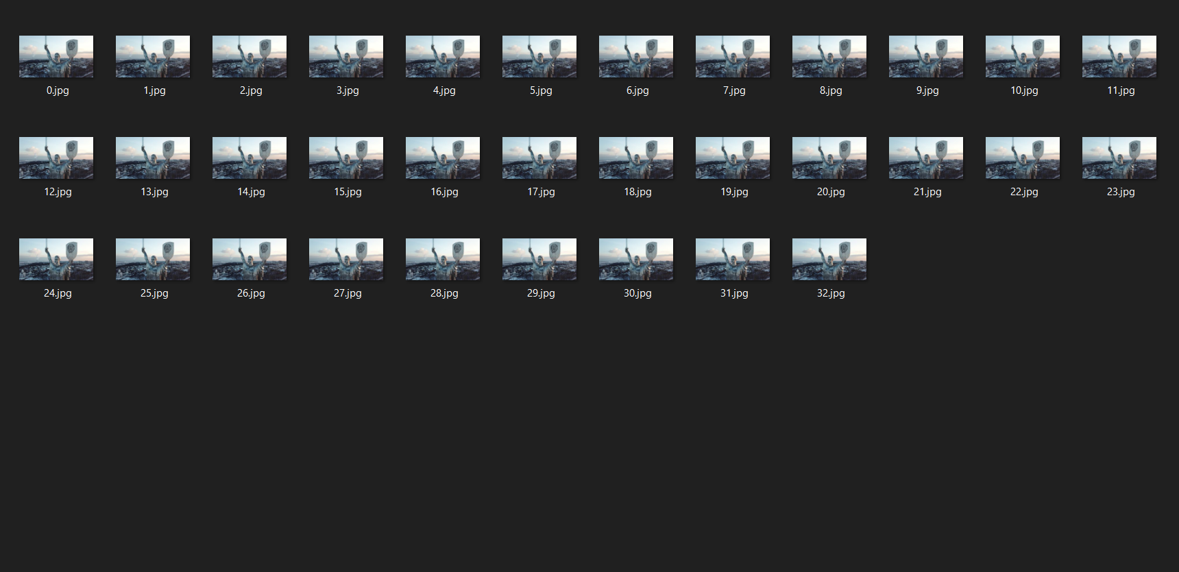

Slide 22
Designing The Turntable

Slide 23
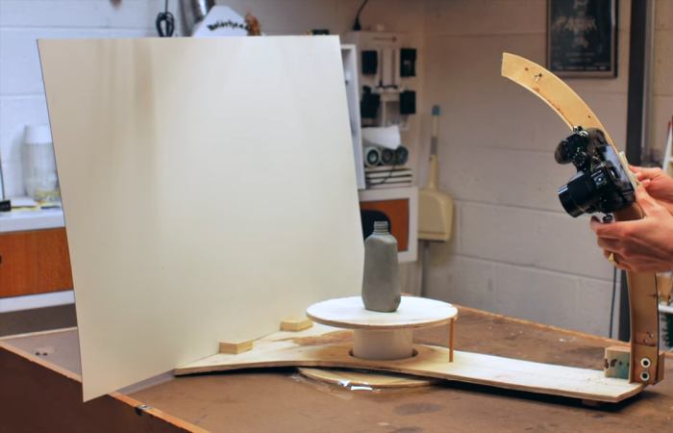
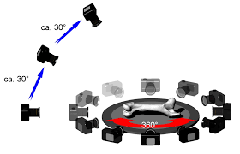
Ideas
Revolving Camera
Notes:
Issues with initial design :
Larger setup , difficult to move around
Instability and vibrations due to the arm which may lead to blurry photos
Manual work required

Slide 24
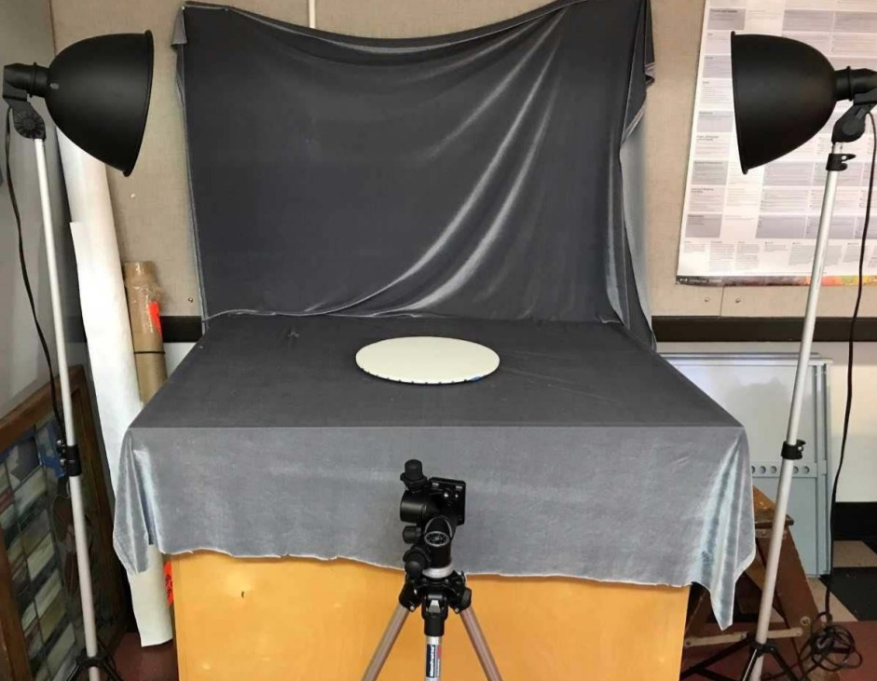
Ideas
No human interaction required
Greater Stability
Less space required
Easier to assemble
Camera remains stationary
Rotating Object

Slide 25
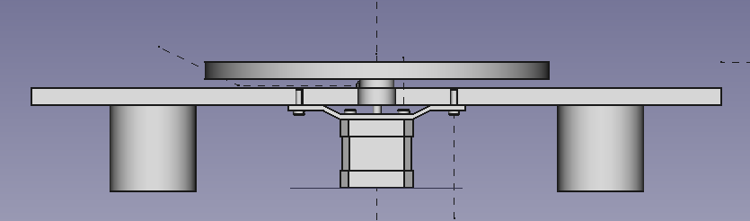
Designing The Turntable
Components
Stepper Motor
Clamp
Shaft Coupler
Turntable
Fasteners
Base

Slide 26
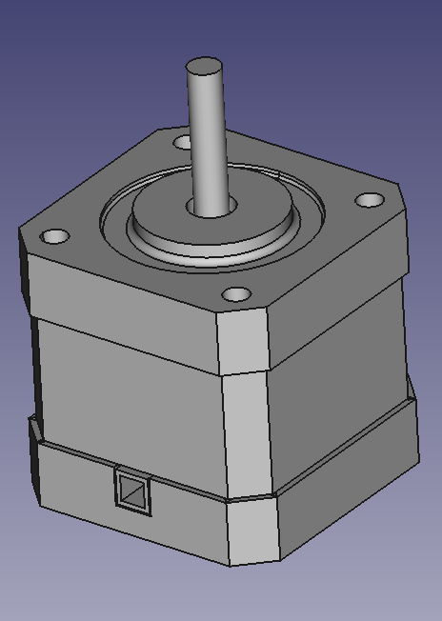
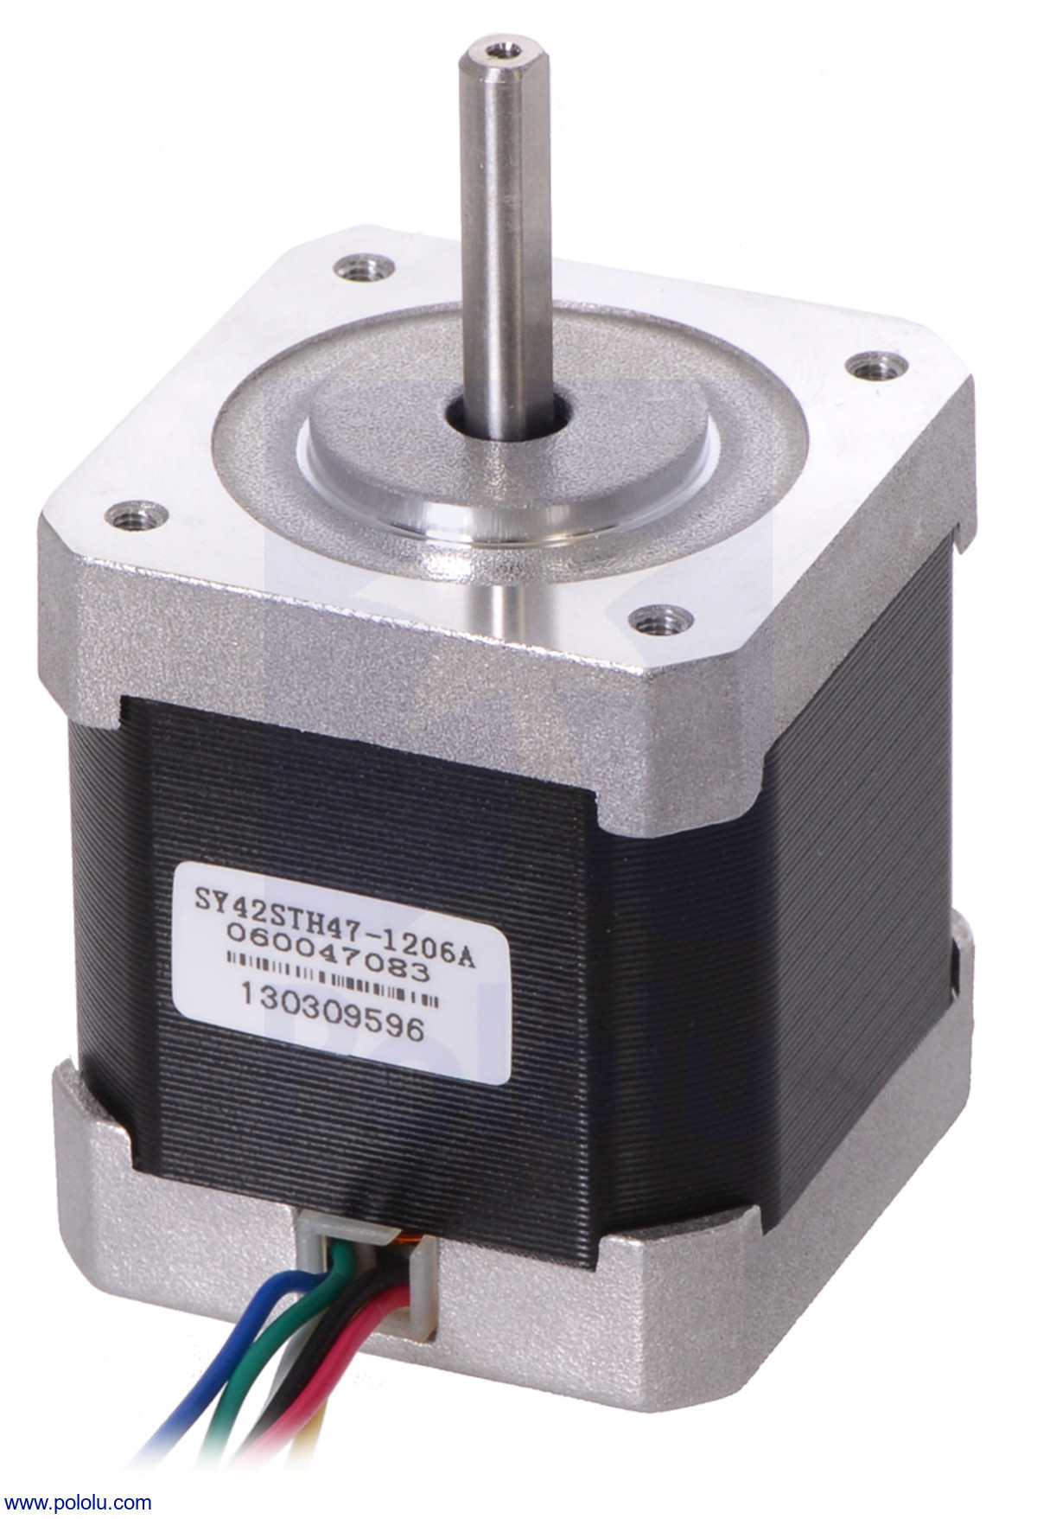
Stepper Motor Specs
Nema 17 Stepper Motor
Model No. - SY42STH47-1206A
Holding Torque : 31.1 N.cm
Rated Voltage : 4.0 V
Rated Current : 1.2 A
Motor Length : 40 mm
Shaft Diameter : 5 mm
Step angle : 1.8°

Slide 27
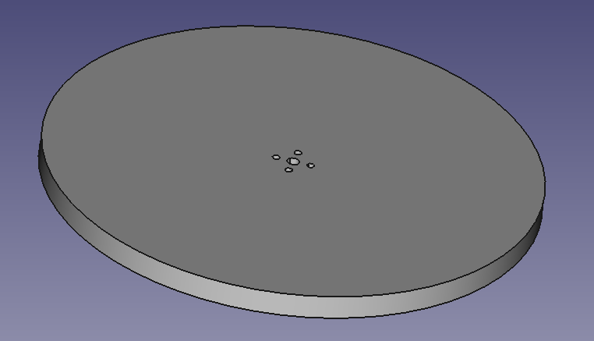
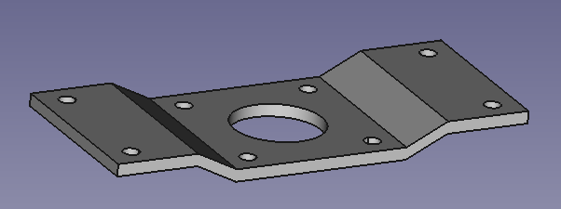
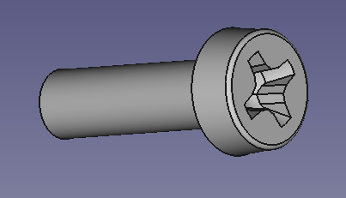
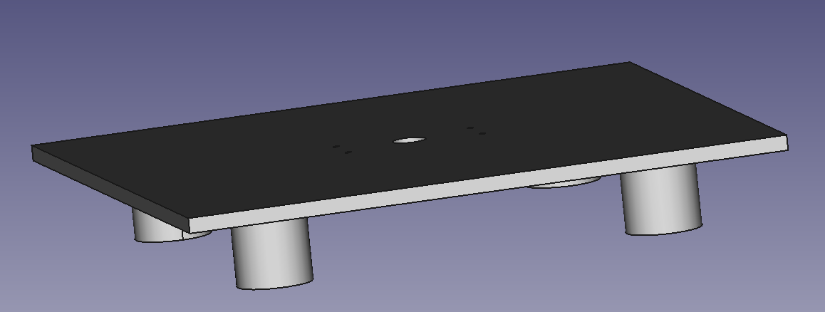
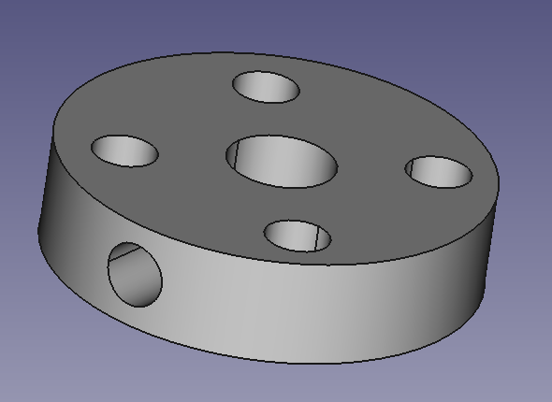
Other Components
Clamp
Fastener
Turntable
Shaft Coupler
Base

Slide 28
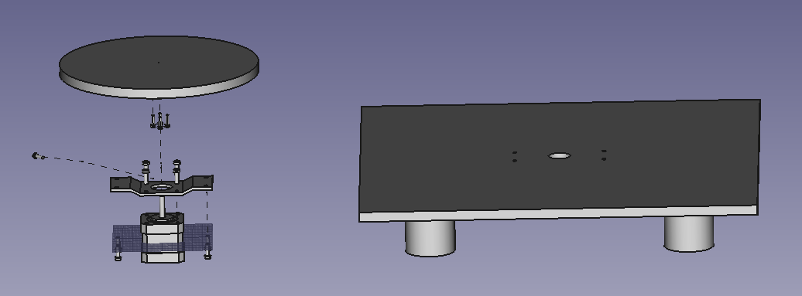
Exploded Assembly

Slide 29
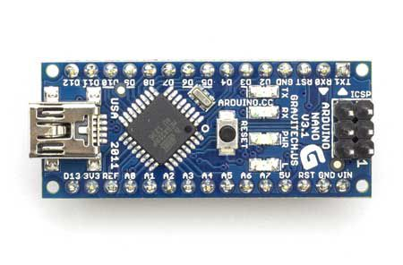
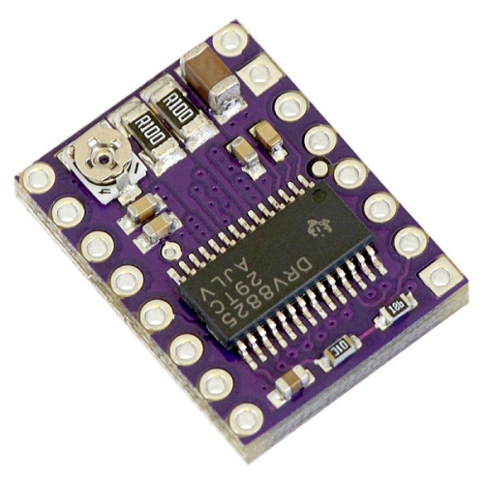
Controlling the turntable
The turntable would be controlled using a NEMA 17 stepper motor
The motor will be interfaced with a microcontroller(Nano) and driven using a DRV 8825 stepper motor driver

Slide 30
Testing 3D reconstruction on insects

Slide 31
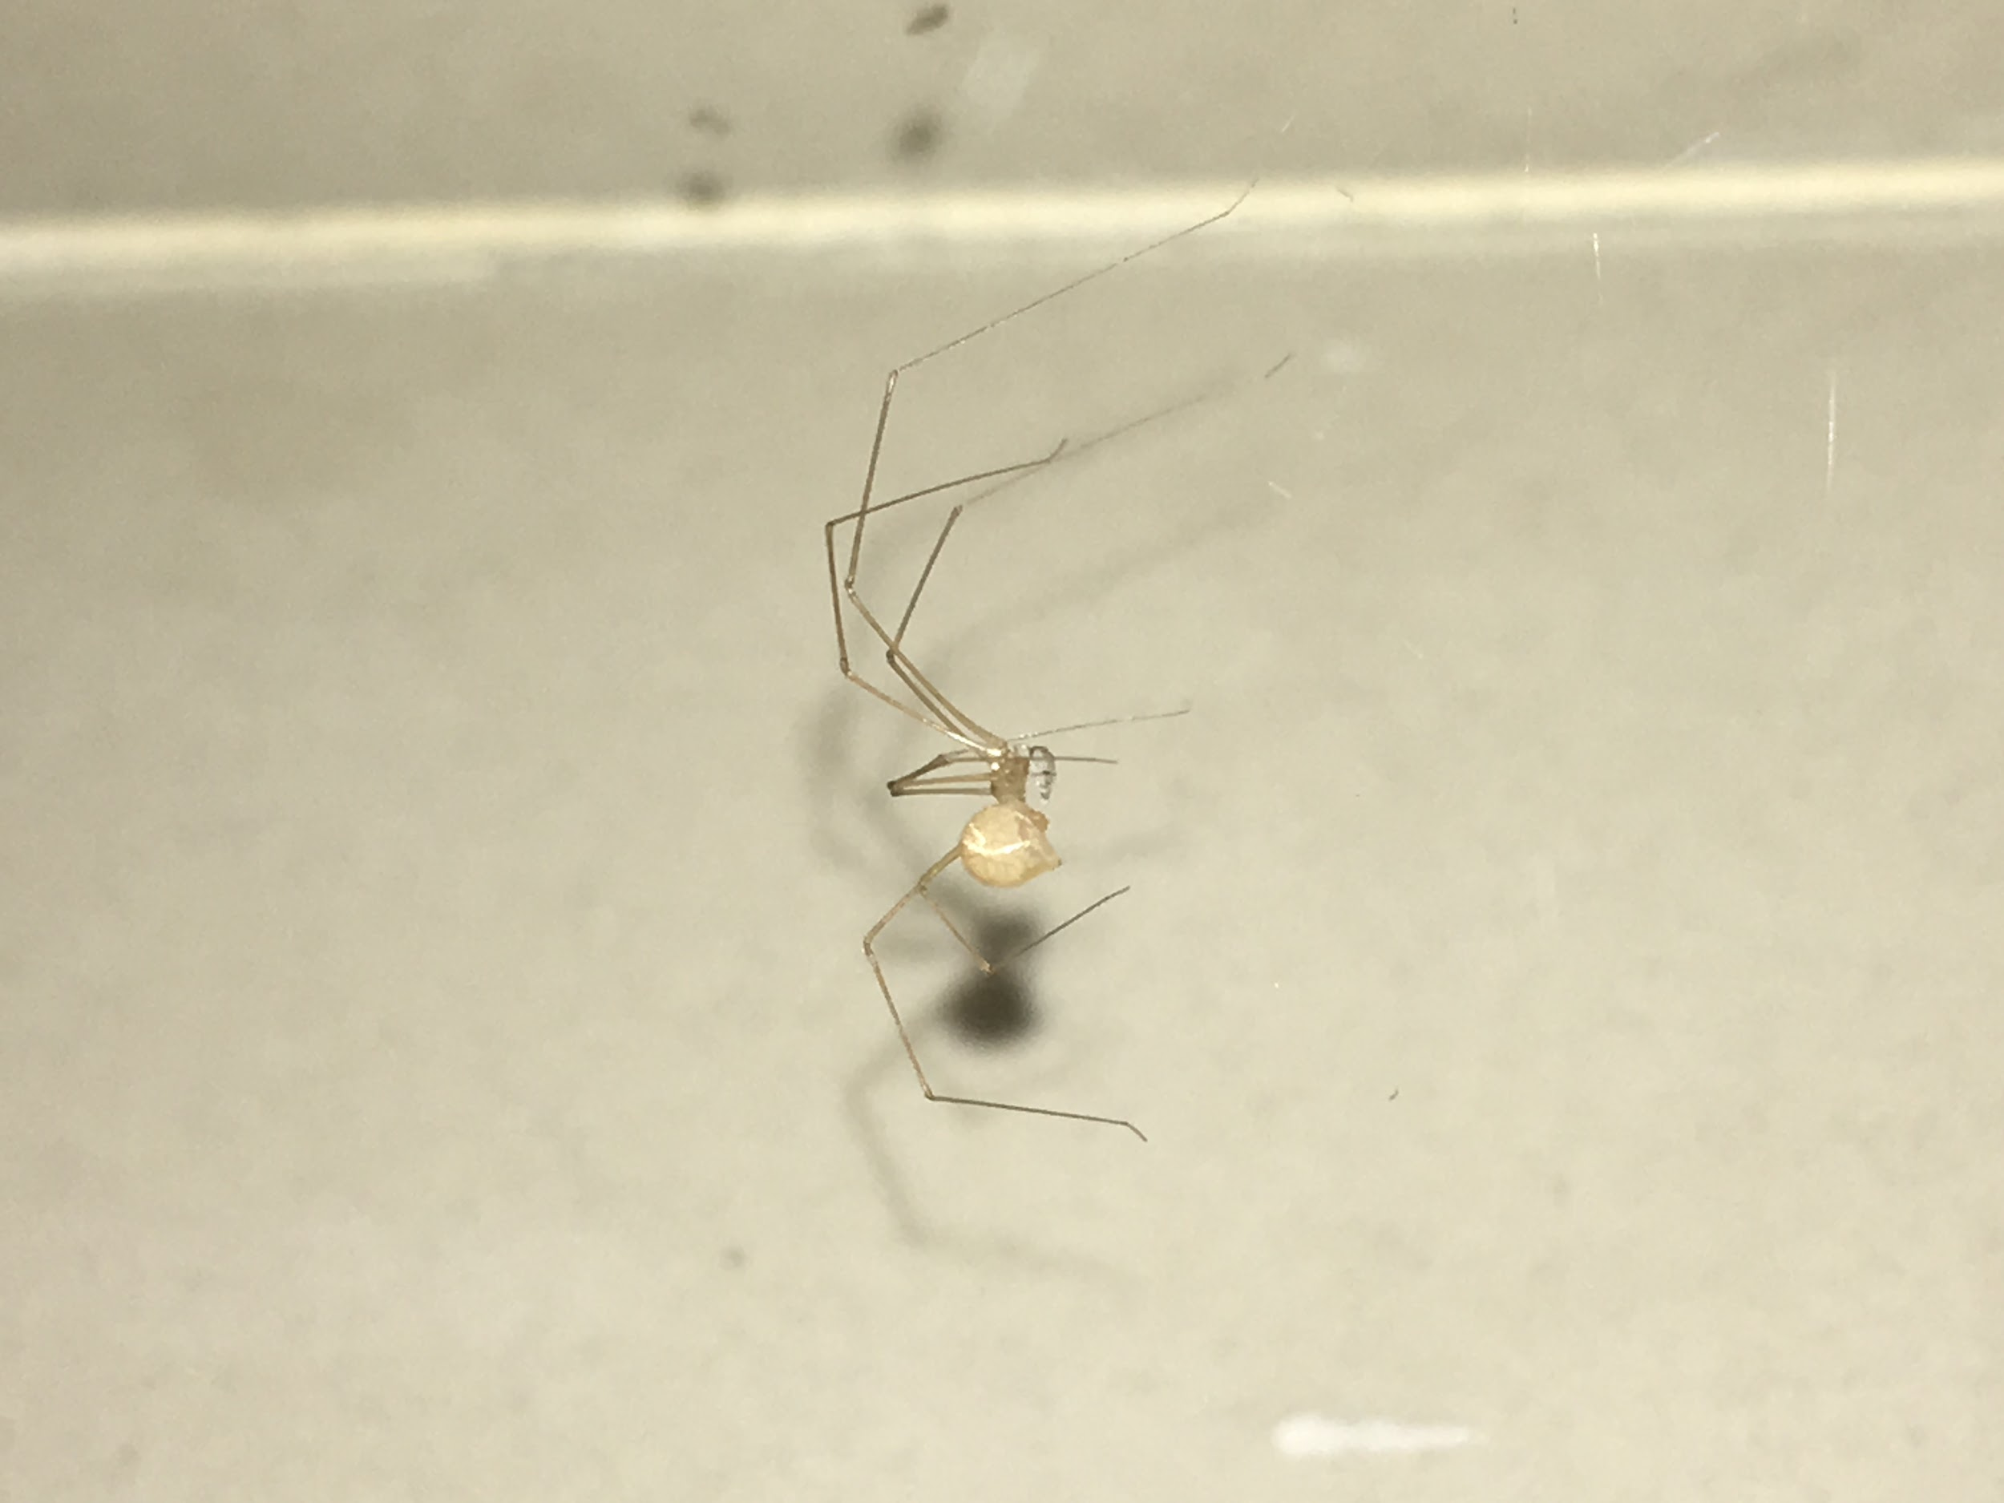
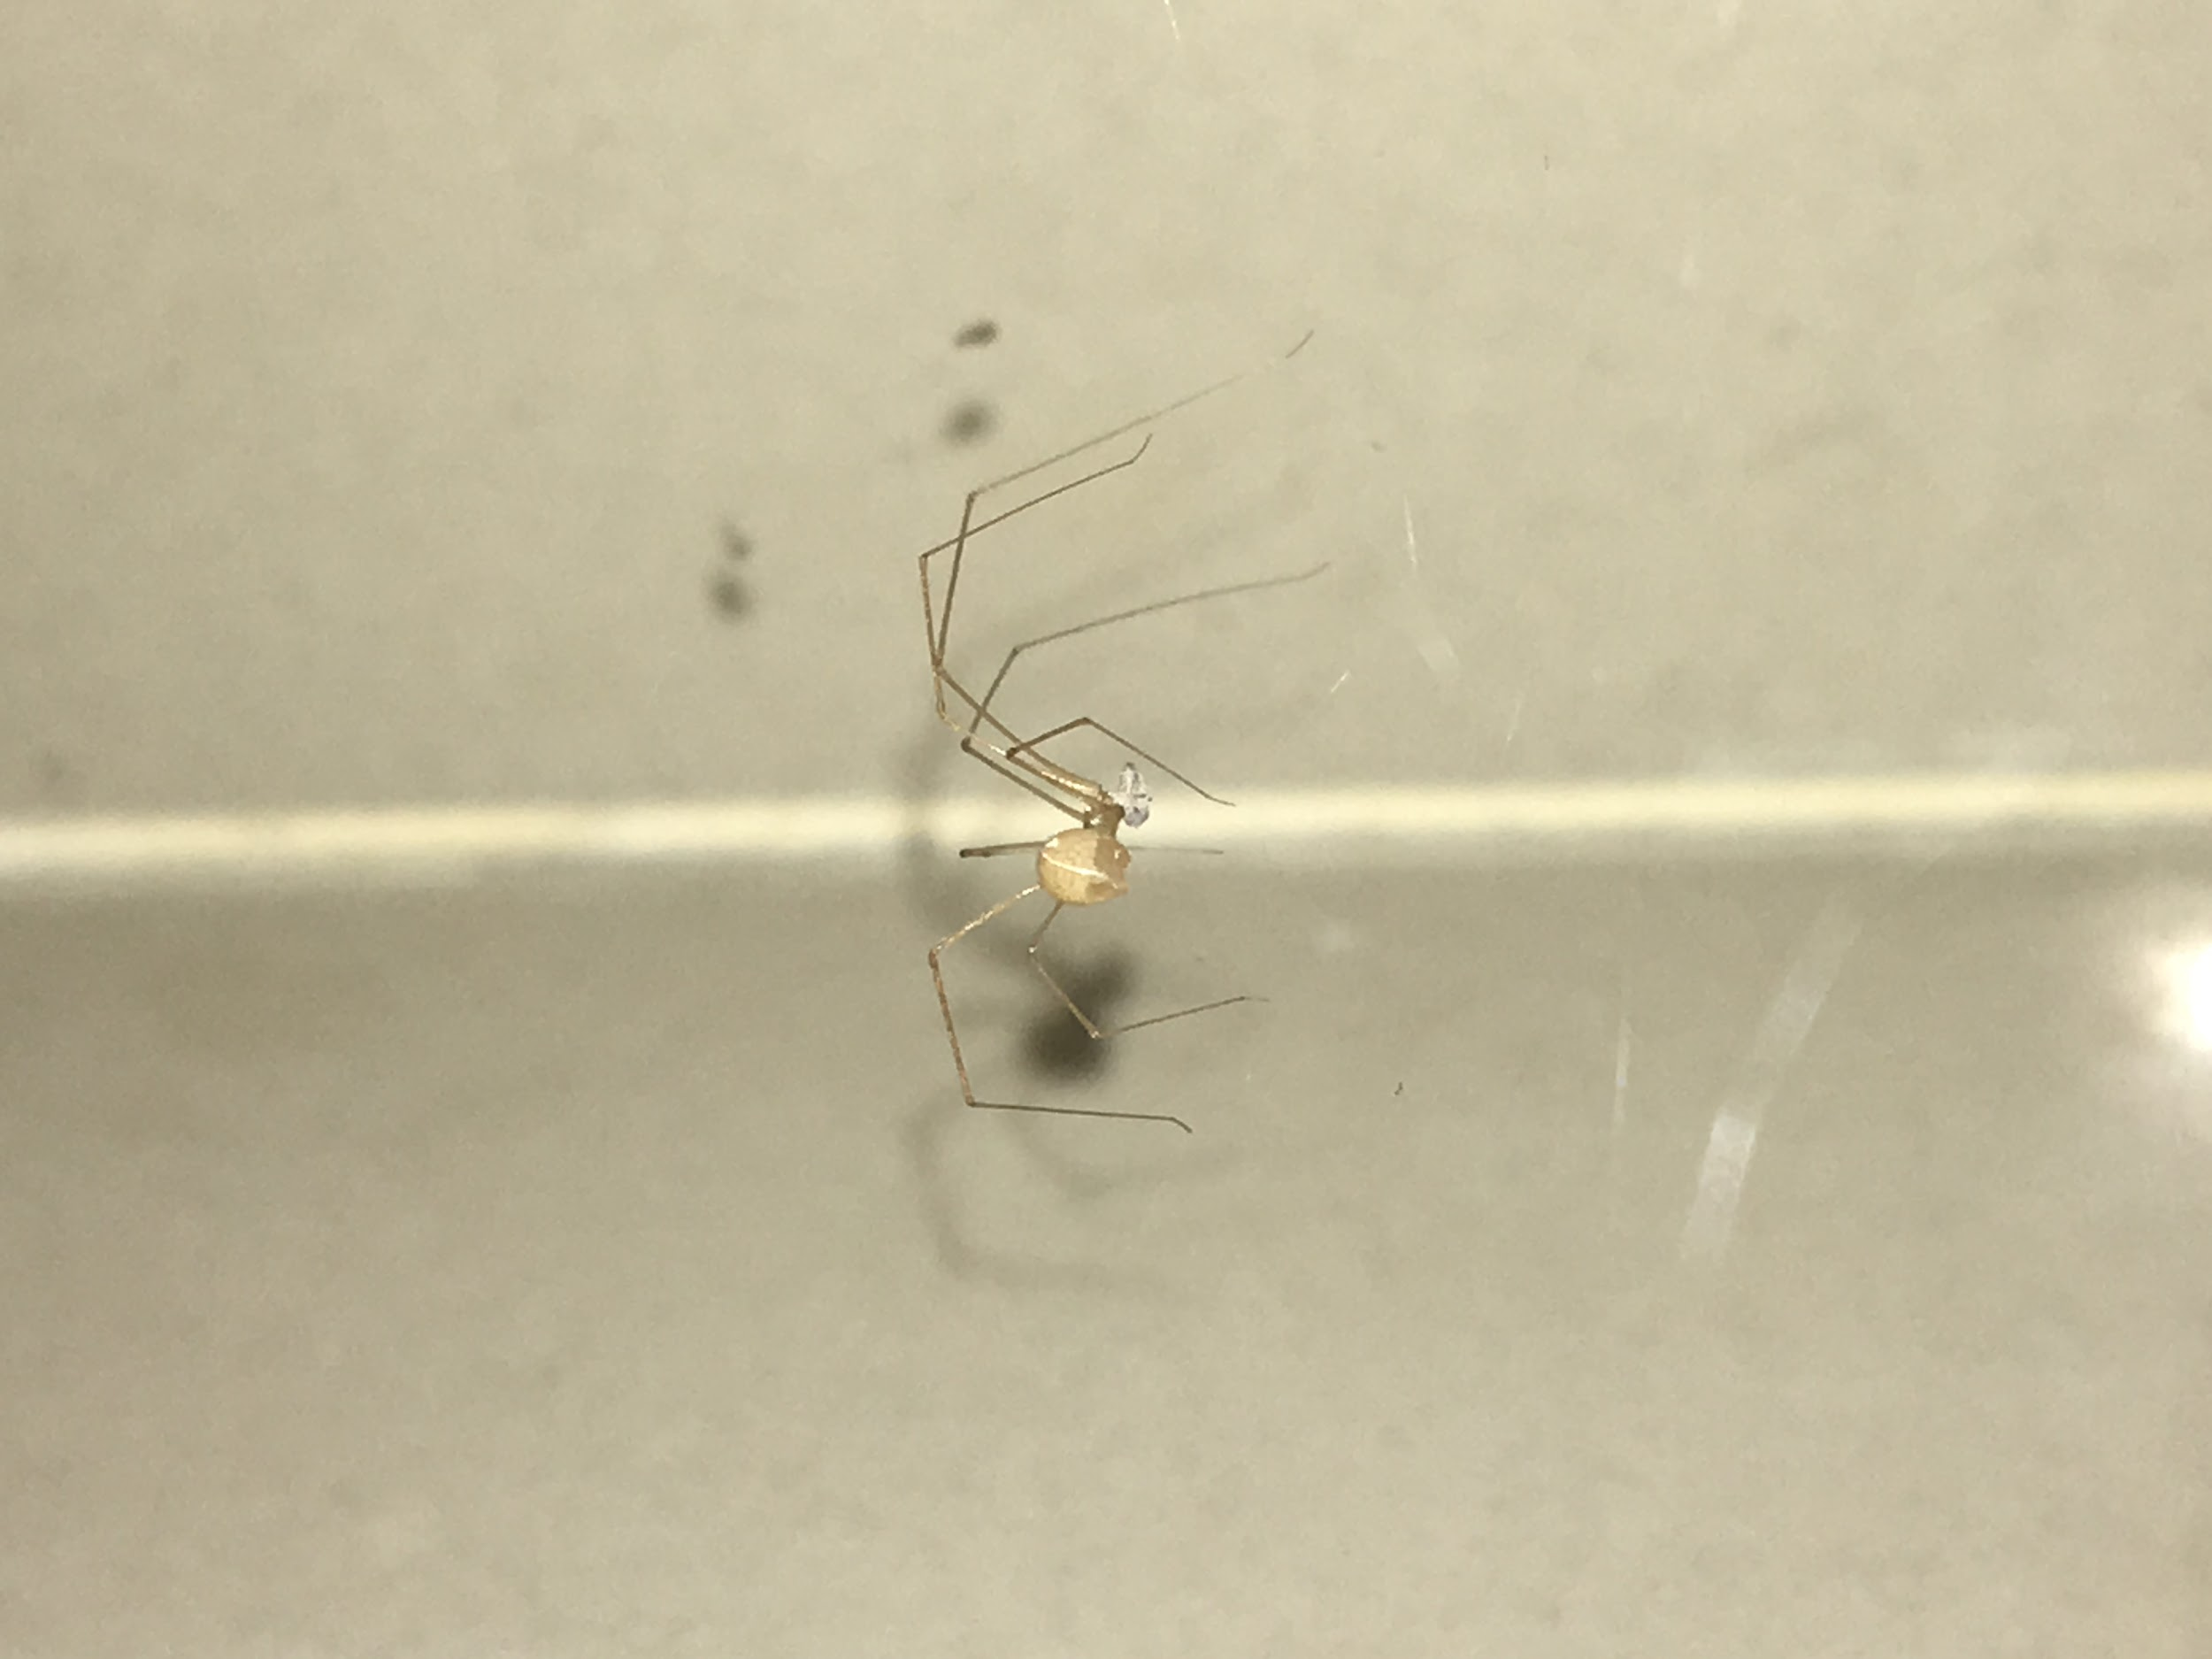
Dataset
Over 90 images of a spider were collected on a regular phone, at various angles
Larger dataset was chosen due to low resolution of the insects body
Photos were taken manually due to reduction in resolution from taking a video

Slide 32
Results
The output, even after manual configuration, wasn’t good due to low resolution of the insects body
There was also a lack of background landmarks for the software to use for feature matching
The result was only a couple of points being generated from the entire datasets, and a dense reconstruction failed due to less number of vertices
For better results, one would need access to a high detail camera, which we didn’t have access too

Slide 33
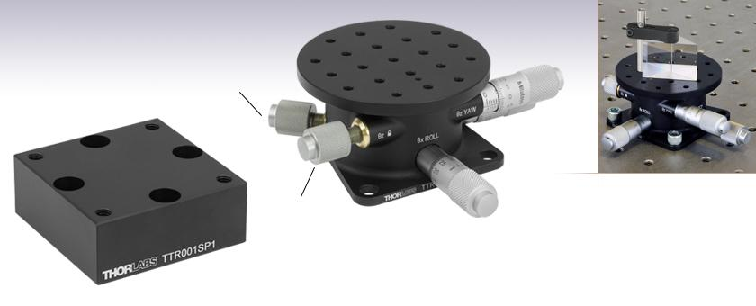
Microscope Stage
Producing Digital Terrain Models of microscopic images
Tilt Stage :
± 5° Tip and Tilt
± 10° Rotation
Micrometer Positioning
TTR001

Slide 34
WHAT NEXT?

Slide 35
Web Application
Notes:
Reason for implementing a web app was to eliminate the issue of installing openMVG-openMVS on individual PCs, which is a cumbersome task. The web app can be deployed on a PC or a server that has dedicated computing power providing accessibility to people who lack the compute resources.
The user only has to gather the image dataset, or take a video of an object and the web app would extract images and process those images to output the final reconstructed mesh.

Slide 36
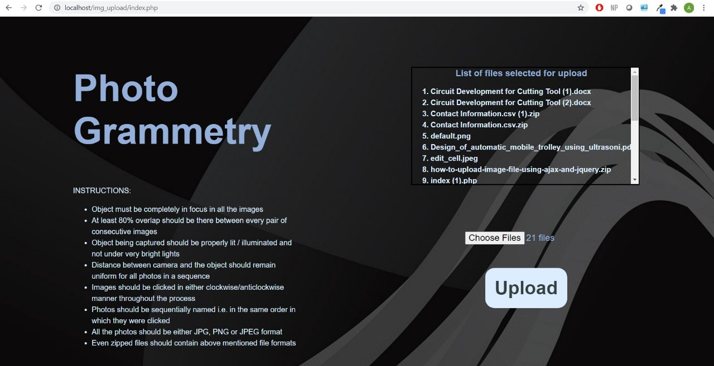

Slide 37

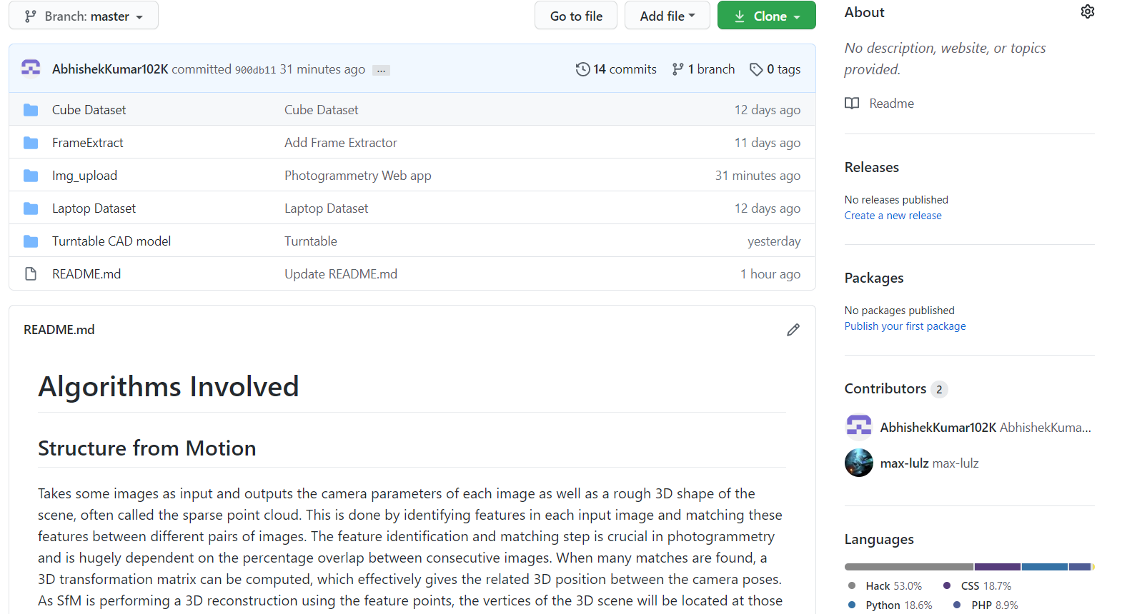
Documentation
Link to our GitHub Repository
https://github.com/AbhishekKumar102K/Photogrammetry

Slide 38


